Slide 1
AUTONOMOUS HOUSE CLEANING ROBOT WITH DEBRIS CLASSIFICATION FEATURE USING ADVANCED ML ALGORITHMS
MAJOR PROJECT
on
Advisor:
Dr. Gaurang Ruhela
Presented By:
Siddartha Royal (20MCE1009)
Jayanth MS (20MCE1011)
Jayanth K (20MCE1013)
DEPARTMENT OF MECHANICAL ENGINEERING
17 th May 2024

Slide 2
Index:
S.No | Content | Slide No.
1 | Introduction | 3
2 | Problem statement & Objectives | 4
3 | Literature Review | 6
4 | Hardware and software components | 16
5 | Methodology and System Architecture | 19
6 | Detailed Workflow and Training ML model | 22
7 | Robot layout design and Assembly | 37
8 | Arduino Setup | 42
9 | Conclusion | 43
10 | References | 44

Slide 3
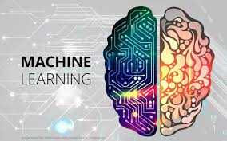
Introduction :
Autonomous machines are self-operating systems or devices capable of making decisions and performing tasks without human intervention. They rely on sensors, Machine learning algorithms, and artificial intelligence to navigate, analyze data, and execute actions, making them valuable in various fields such as robotics, transportation, and manufacturing.
[1]

Slide 4

Problem Statement
In today's fast-paced modern lifestyles, time is precious. Automation and autonomy in daily tasks has become pivotal. In this era, the relentless pace of life leaves little time, emphasizing the need for efficiency and time-saving innovations. Despite having hectic lifestyle, maintaining cleanliness and hygiene is mandatory for peaceful environment. So, A house cleaning robot, offering autonomy in household chores, becomes indispensable.

Slide 5
Objectives
The objective of this project is to design and develop an autonomous house cleaning robot that efficiently cleans various surfaces, navigates obstacles, and enhances household convenience. It is also accustomed with following features:
Automated Spill Detection
Debris classification
Effective Cleaning Actions
Real-Time Responsiveness
Compact size

Slide 6

Literature survey:
No | Title/ Author | Source | Key Points
1. | Cascaded Machine-Learning Technique for Debris Classification in Floor-Cleaning Robot Application. Balakrishnan Ramalingam, et al.(2018) | APPLIED SCIENCES, Multidisciplinary Digital Publishing Institute. | The study presents a novel debris detection and classification approach for autonomous floor-cleaning robots, utilizing a cascaded method combining a deep Convolutional Neural Network (CNN) and Support Vector Machine (SVM). Results show high accuracy (95.5%) in identifying and classifying solid and liquid spillage debris, with superior performance compared to existing techniques.
2. | Table Cleaning Task by Human Support Robot Using Deep Learning Technique.Jia Yin, et al.(2019) | Sensors, Multidisciplinary Digital Publishing Institute | This study introduces a table cleaning and inspection method employing a Human Support Robot in a real-world food court setting. It utilizes a lightweight Deep Convolutional Neural Network (CNN) for food litter recognition and a planner framework for cleaning path generation. The food litter detection module achieves an impressive 96% detection accuracy, facilitating cleanliness inspections and different cleaning modes.

Slide 7
No | Title/ Author | Source | Key Points
3. | Design and Development of Controller Based Automatic Ground Cleaning Robot. R.Gopalakrishnan.et.al(2022). | Scientific report,IEEE | The major findings of this research involve the development of an Automatic Floor Cleaning Robot using Arduino UNO, Bluetooth module, and other components for dry, wet, and UV cleaning. The compact design here is the main point, allows the robot to access tight spaces, and further improvements can be made to maximize its cleaning contact with the floor.
4. | A Short History of Cleaning Robots. Erwin Prassller.et.al.(2004) | Scientific report,IEEE. | Developed an autonomous robot system combining advanced sensor fusion for target recognition and adaptable path planning in dynamic environments, showcasing resilience on a Khepera robot. Integration of fuzzy logic-based sensor fusion and dynamic path planning exhibited robust target collection abilities amidst evolving environments, marking significant strides in autonomous robotics.

Slide 8
No | Title/ Author | Source | Key Points
5. | Application of deep learning and machine learning models to detect COVID-19 face masks. Mbunge,et al.(2021) | Science Direct | They proposed a hybrid model with SVM, decision trees, and ensemble methods, achieving 99.64% testing accuracy. However, its heavy computational requirements limit deployment on low-end devices. They emphasized the importance of authentic datasets, especially advocating for real-world face mask images to enhance precision and applicability in detection systems.
6. | Object detection with deep learning. Zhao,et.al.(2019) | Scientific report,IEEE. | Their R-CNN framework revolutionized object detection with CNN features for region-based detection. Their fast R-CNN model integrated proposal generation and feature extraction, setting new speed and accuracy standards. The YOLO model further advanced real-time detection with a single-stage architecture, showcasing the potential for efficient and accurate object detection across applications.

Slide 9
No | Title/ Author | Source | Key Points
7. | Deep learning models for plant disease detection and diagnosis. Ferentinos,et.al(2018) | ScienceDirect. | He developed a semi-automatic system for soybean leaf disease detection and severity prediction, utilizing a dataset of 4775 images across four classes. Employing Support Vector Machine (SVM) as a classifier, they attained an impressive overall accuracy of nearly 90%. However, the model's potential heaviness due to multiple clusters could limit its deployment on low-end devices despite its high accuracy.
8. | Variable generalization performance of a deep learning model to detect pneumonia in chest radiographs. Zech,et.al(2018) | PLOS | They evaluated pneumonia-screening CNNs across NIH, MSH, and IU using 158,323 chest radiographs. Models trained on NIH or MSH data performed similarly on IU but not on each other's data, revealing potential biases. Combining data from MSH and NIH improved internal but not external performance, highlighting challenges in generalizing CNN models across institutions.

Slide 10
No | Title/ Author | Source | Key Points
9. | Green leaf disease detection using raspberry pi. Sankar.et.al.(2019) | IEEE Xplore | He initially proposed a k-means classifier for plant leaf disease detection but lacked vital dataset information and accuracy. In a subsequent study, they enhanced the concept with a semi-automatic system for soybean leaf detection, achieving nearly 90% accuracy using SVM on a dataset of 4775 images. However, concerns arise regarding the model's bulkiness due to multiple clusters, potentially limiting its deployment on low-end devices and practicality for real-life plant disease diagnosis.
10. | IOT Surveillance Robot Using ESP-32 Wi-Fi CAM & Arduino. Venu, D. N.et.al.(2022). | Research Gate | He highlights the ESP32 camera's utility in robotics, leveraging its Wi-Fi and Bluetooth capabilities for wireless communication and sensor integration. With motor driver compatibility and a dual-core processor for real-time data processing, it enables precise movement control. Hosting a web server facilitates remote control via a user-friendly interface. While facing challenges in real-world testing and application-specific optimization, as noted by Sanker [20], the ESP32 remains a potent platform for diverse robotic applications.

Slide 11
No | Title/ Author | Source | Key Points
11. | Tinyml-enabled frugal smart objects: Challenges and opportunities. Sanchez-Iborra.et.al.(2020) | IEEE Xplore | They] review the integration of Machine Learning (ML) into Microcontroller Units (MCUs) via TinyML. They explore frameworks for this integration and present a real use case of intelligent interface selection in multi-Radio Access Technology (RAT) devices. Experimentation reveals decision trees and Random Forest (RF) as optimal performers on an Arduino Uno board.
12. | A lightweight quantized cnn model for plant disease recognition. Rakib.et.al.(2022). | Springer Linl | He introduce a lightweight CNN model for plant leaf disease classification, achieving 98% accuracy with int8 quantization. Deployable on microcontrollers like ESP32-CAM, its small size (28KB) and fast inference time (39.2ms) enable efficient real-time detection, offering practical solutions for farmers and potentially addressing food shortages. Future work aims to expand disease recognition capabilities and develop a mobile app for identification and remedy suggestions, enhancing accessibility and impact.

Slide 12
No | Title/ Author | Source | Key Points
13. | A Comprehensive Android App Based Solution for Automated Attendance and Management in Institutions Using IoT and TinyML. A. Paul.et.al.(2023) | IEEE Xplore | They present an IoT-based education management system using ESP-32 CAM for face recognition and Flutter for mobile app development. Integrated with TinyML and Edge Impulse, it ensures accurate attendance tracking and efficient communication. With modular design and secure data storage in Google Sheets, it streamlines education administration, offering features like class notifications and event updates, revolutionizing educational processes.
14. | MobileNetV2 Model for Image Classification. K. Dong.et.al.(2020). | IEEE Xplore | They compare MobileNetV1 and MobileNetV2 models, showing MobileNetV2's superior accuracy and shorter training duration. Their analysis, including visualization with saliency maps, confirms MobileNetV2's effectiveness in image classification. Future research could focus on expanding datasets and implementing functions like segmentation and object detection to enhance MobileNetV2's performance further. Overall, MobileNetV2 offers a promising solution for image classification, surpassing MobileNetV1 in accuracy and efficiency.

Slide 13
No | Title/ Author | Source | Key Points
15. | Fruit image classification model based on MobileNetV2 with deep transfer learning technique. Gulzar, Yonis.et.al.(2019) | MDPI | He introduce TL-MobileNetV2, achieving 99% accuracy in fruit classification. Outperforming previous methods, it promises practical deployment in mobile apps. Future plans include dataset expansion and comparative analysis with other CNN models to enhance precision agriculture, particularly in fruit classification and disease prediction.
16. | Melanoma image classification based on MobileNetV2 network.. Indraswari.et.al.(2022). | Science Direct | She propose a melanoma classification method using MobileNetV2, achieving up to 85% accuracy on the ISIC-Archive dataset. The method outperforms other models and shows promise for practical deployment on mobile devices, aiding in early melanoma detection and potentially reducing mortality rates associated with this common cancer.

Slide 14
No | Title/ Author | Source | Key Points
17. | Tinyml: Machine learning with tensorflow lite on arduino and ultra-low-power microcontrollers. Warden.et.al.(2022). | Google Books | He propose TensorFlow Lite on Arduino and ultra-low-power microcontrollers for efficient edge machine learning. This allows real-time inference, optimizing for memory and computational efficiency. Deploying on ultra-low-power MCUs extends battery life, making it ideal for various IoT and embedded applications requiring intelligent edge computing.
18. | TinyML: analysis of Xtensa LX6 microprocessor for neural network applications by ESP32 SoC. Zim.et.al.(2022). | Arxiv | They proposed integrating machine learning with microcontrollers like ESP32 to advance edge computing. They explore efficient neural network acceleration without specialized hardware, suggesting potential speedup benefits for optimized machine learning on resource-constrained devices.

Slide 15
No | Title/ Author | Source | Key Points
19. | Brushless DC motor control on arduino platform. Mach.et.al.(2018) | TBU | He examine high-speed brushless DC (BLDC) motors, emphasizing their suitability for UAVs due to compactness and efficiency. They detail Electronic Speed Control (ESC) systems, showcasing integration with microcontrollers like Arduino. Experimental validation confirms Arduino's feasibility for BLDC motor control, promising further UAV research.
20. | TinyML-CAM: 80 FPS image recognition in 1 kB RAM. Sudharsan.et.al.(2022). | ACM Digital Library | He introduce the TinyML-CAM pipeline, enabling customized machine learning-based image recognition on IoT and AIoT boards. With ultra-lightweight performance on ESP32, it achieves fast inference speeds. This open-source solution is the first to perform RF-based image recognition on AIoT boards. Future plans include reducing processing time for improved frame rates and comprehensive testing across various datasets and IoT boards, similar to the TinyML benchmark.

Slide 16
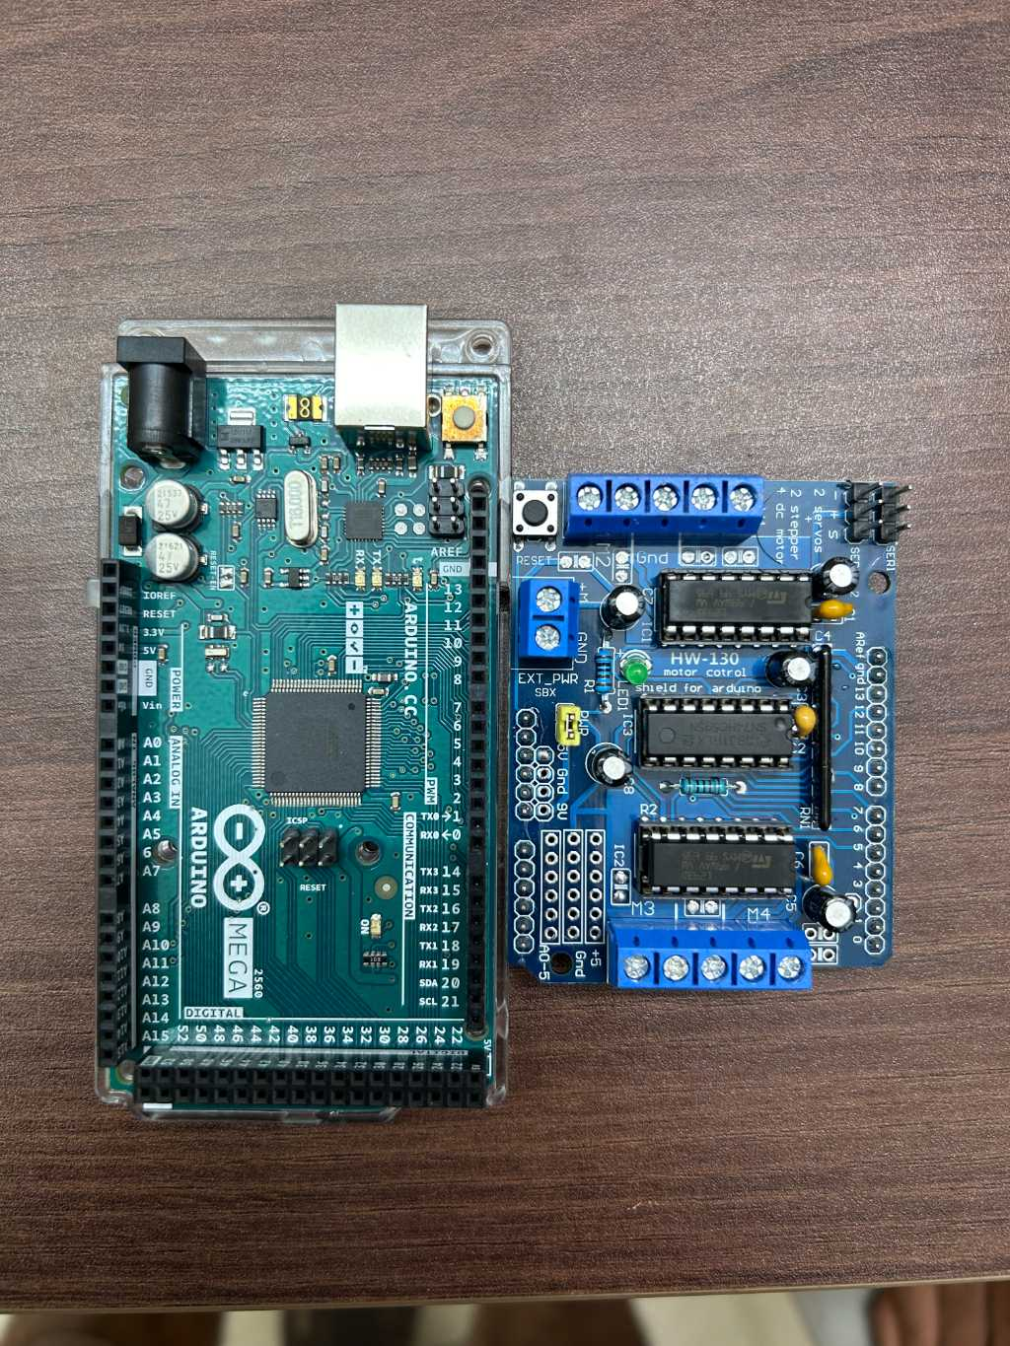
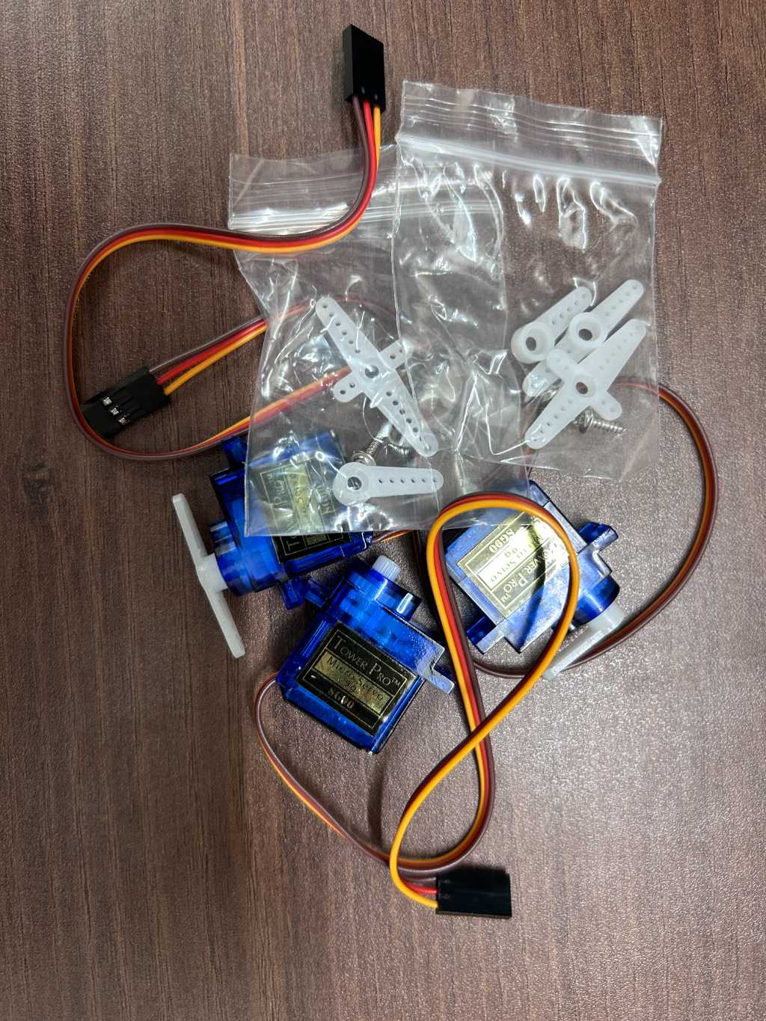
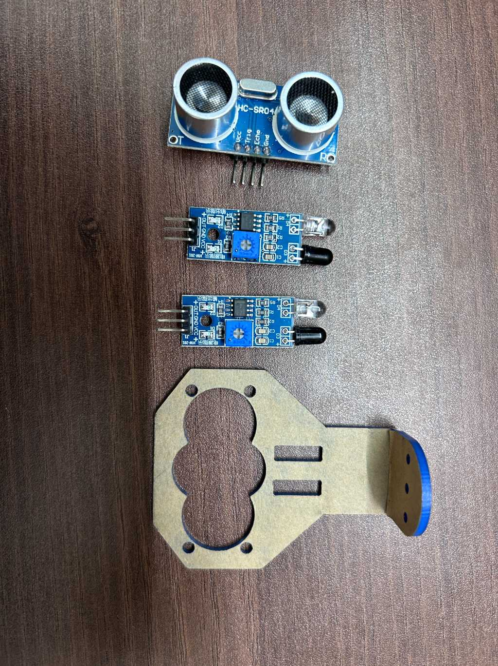
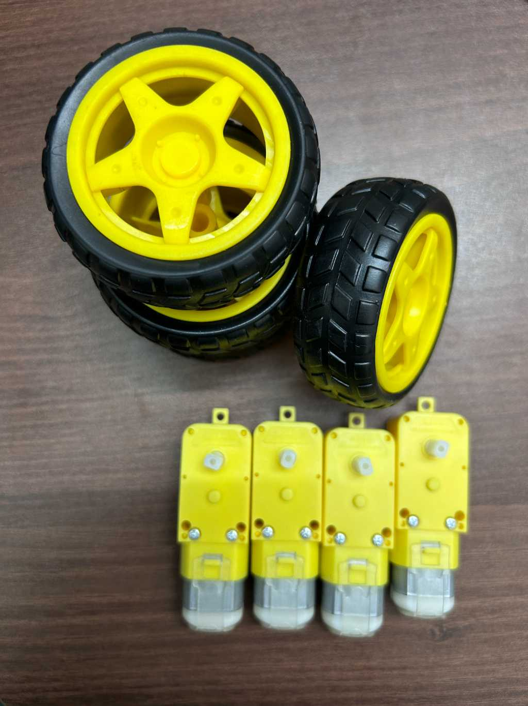
Hardware Components:
Fig 1 Arduino Mega and Motor Shield
Fig 2 IR and UV Sensor
Fig 3 Servomotor
Fig 4 Gearmotor and Wheels

Slide 17
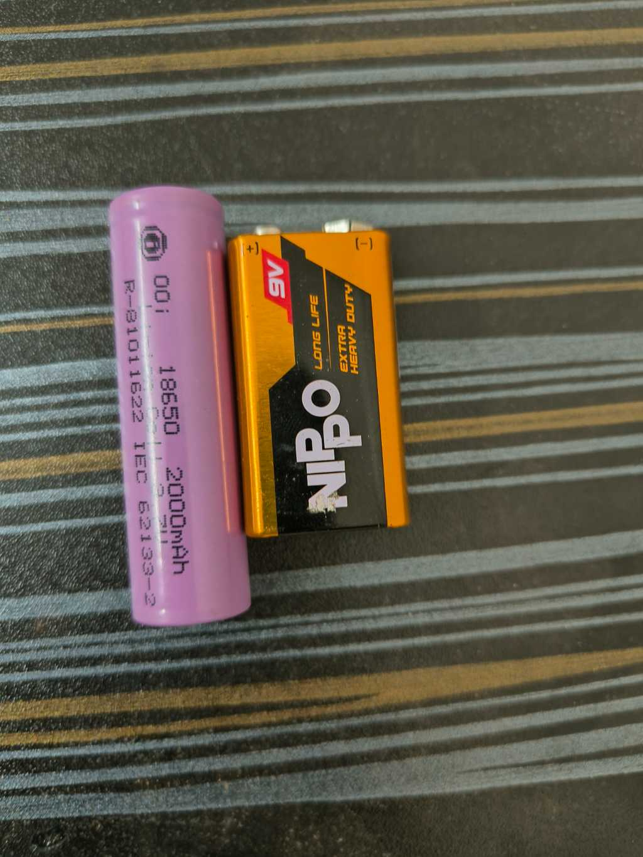
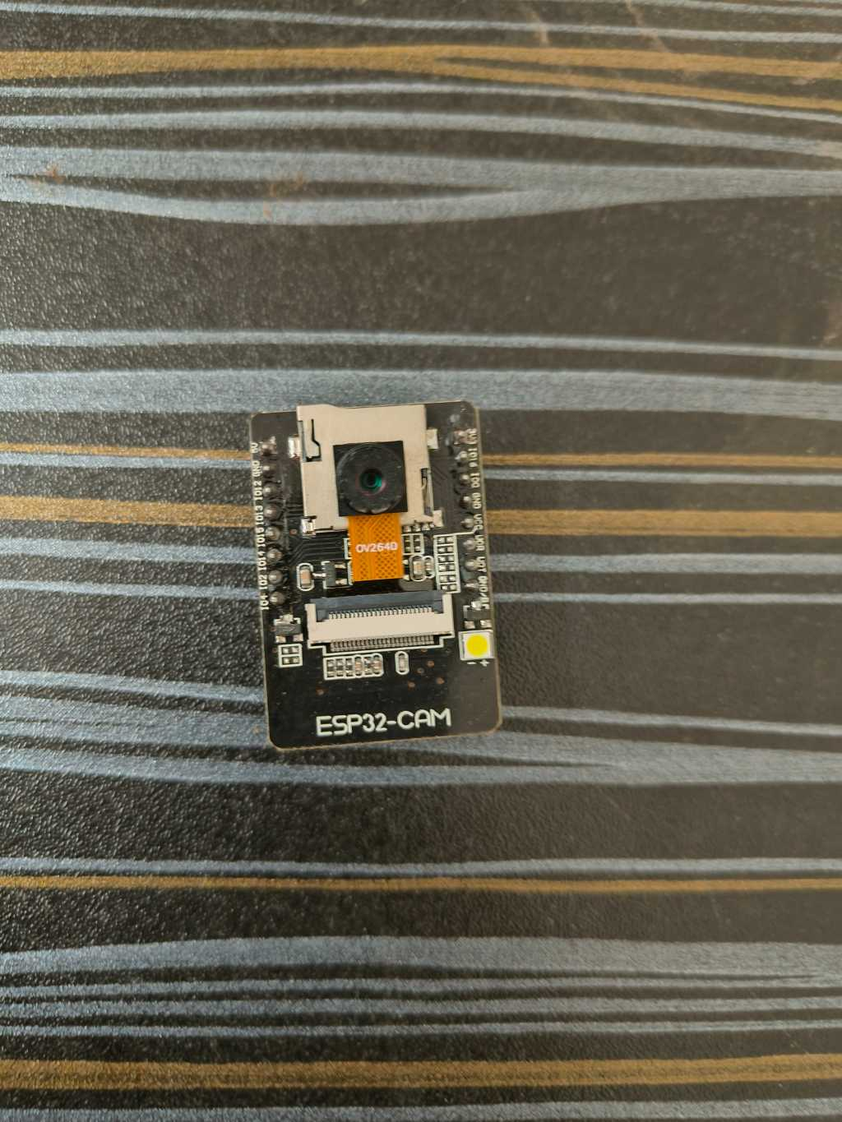
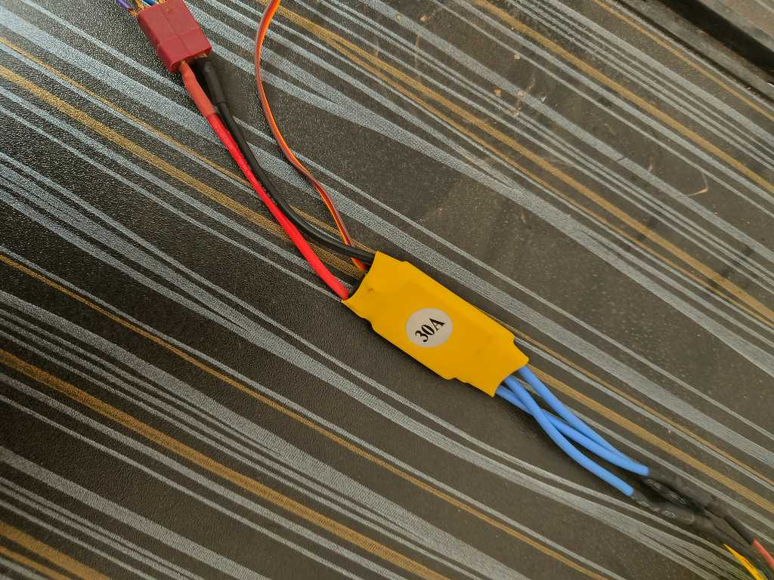
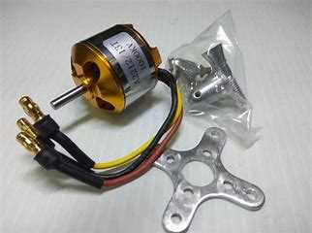
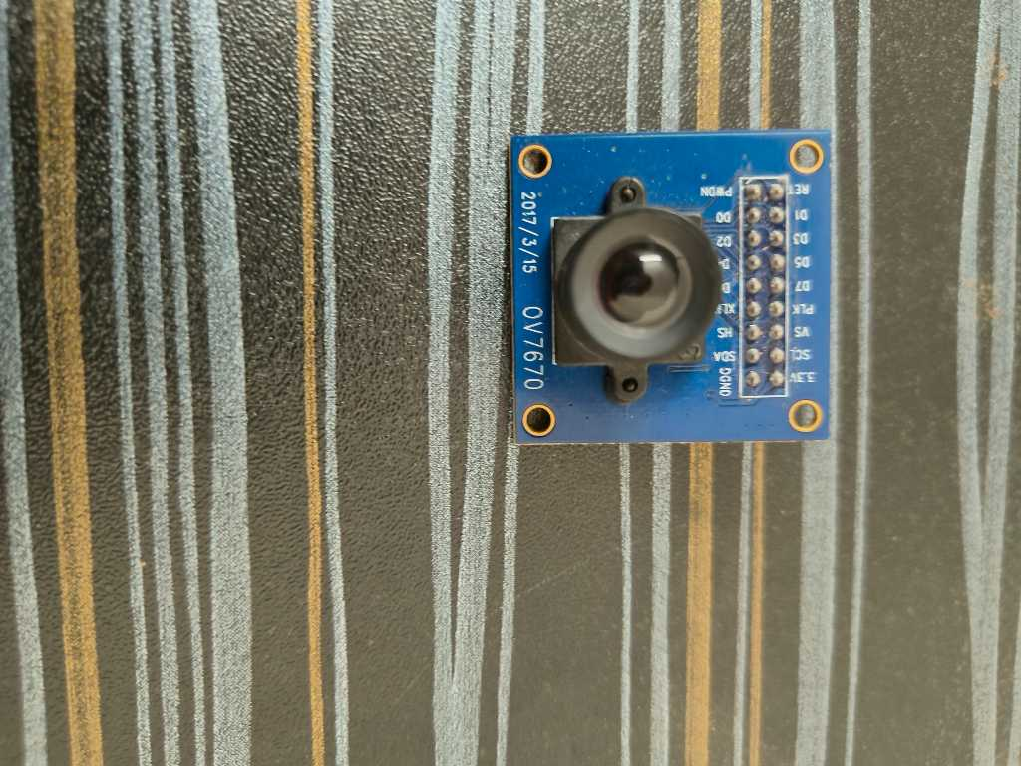
Fig 5 Li-ion and 9v Battery
Fig 6 ESP 32 Camera Module
Fig7 ESC controller
Fig8 BLDC motor
Fig 9 Arducam OV 7670

Slide 18

Software requirements:
Operating System- Windows
Programming languages-
Python
C++
Machine learning Frameworks-
MobileNetV2
TensorFlowLite
Arduino IDE

Slide 19

Methodology
This project employs a multi-faceted methodology, combining Neural networking, sensor fusion and machine learning techniques. It utilizes cameras and sensors to perceive the environment, employs algorithms to map and plan cleaning routes, and utilizes machine learning for obstacle avoidance and surface recognition, ensuring effective and autonomous house cleaning.

Slide 20

System Architecture :
Turning on the robot
Sensor Detection
Data Acquisition
Data Processing
Debris Detection
Decision Making
Action Implementation
Cleaning Mechanism Activation
Cleaning Process
Continuous Monitoring

Slide 21
CNN Framework:
Dataset Preparation
Model Architecture using MobileNetV2
Training Process
TensorFlow Lite Conversion
Model Optimization
Evaluation Metrics
Integration with Edge Impulse
Further Optimization and Quantization

Slide 22
Detailed Workflow:
1.Data collection and sensor integration
Camera image capture- [ESP32 Cam module(2MP)]
Ultrasonic sensor Data collection-[HC-SR04 Ultrasonic Sensor]
2. Sensor Fusion and preprocessing
Data fusion of RGB camera, UV sensor, proximity sensors data.
Preprocess the data using MobileNetV2 for training.
3. Model adaptation
Adapt MobileNet, typically used for image classification, to output navigation commands or actions instead of class probabilities.

Slide 23
4. Model Training
Train the adapted MobileNet model using the preprocessed data. Use supervised learning techniques to minimize the difference between the predicted navigation commands and the ground truth commands provided in the training data.
5. Model Optimization
Optimize the trained model for deployment on resource-constrained devices like the robot's onboard hardware.
6. TensorFlow Lite Conversion
Convert the optimized model to TensorFlow Lite format for efficient inference on mobile and embedded devices. TensorFlow Lite provides tools and APIs to convert TensorFlow models to a format suitable for deployment on edge devices.

Slide 24
7.Deployment on Robot
Deploy the TensorFlow Lite model on the robot's onboard hardware. Integrate the model with the robot's control system to enable real-time inference of navigation commands based on sensor inputs.
8. Testing and Evaluation
Test the deployed model in real-world environments to evaluate its performance. Monitor the robot's navigation behavior and assess metrics such as accuracy, robustness, and efficiency.
9. Iterative Improvement
Continuously collect new data and evaluate the robot's performance. Use this feedback to iteratively improve the model by retraining it with additional data or fine-tuning its parameters.

Slide 25
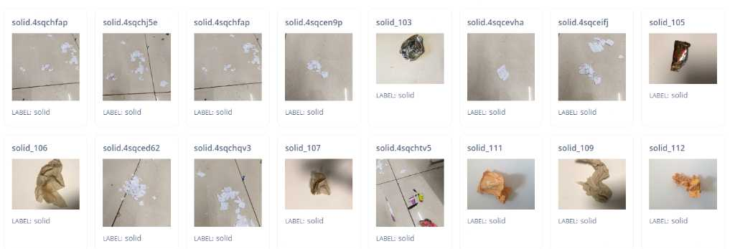
TRAINING ML MODEL:
Dataset acquisition
Kaggle for solid debris dataset(220*2 images)
Bing image downloader python module for liquid spill(220 images)

Slide 26
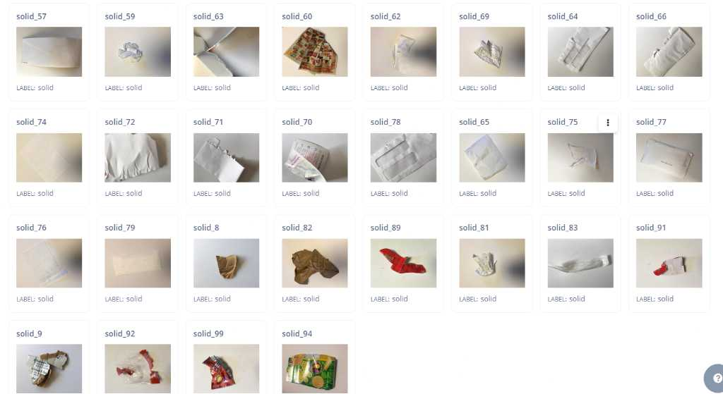

Slide 27
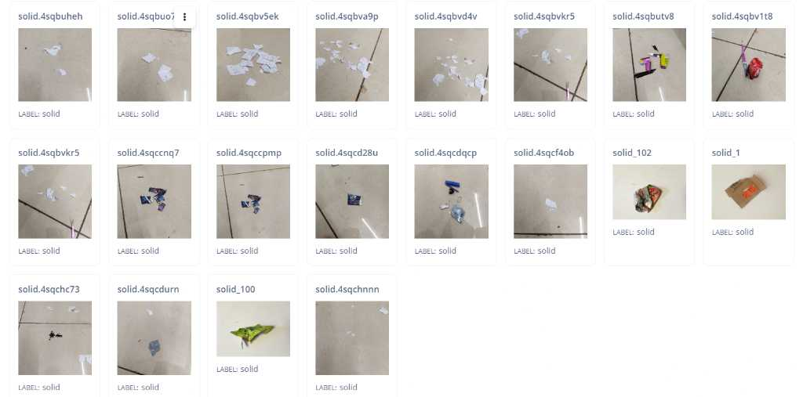

Slide 28
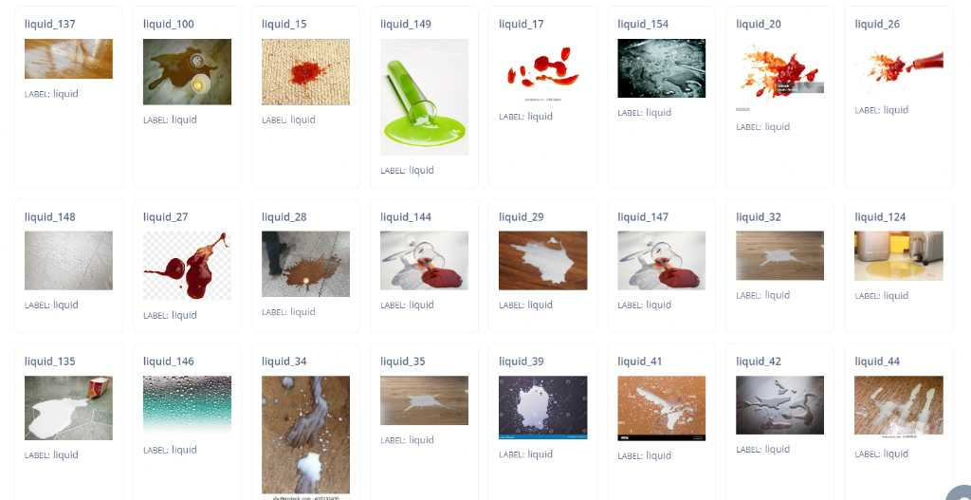

Slide 29
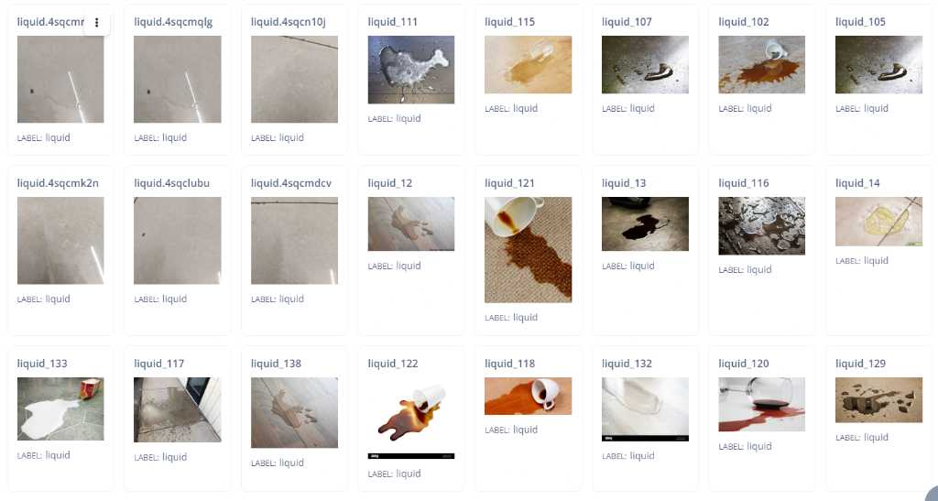

Slide 30
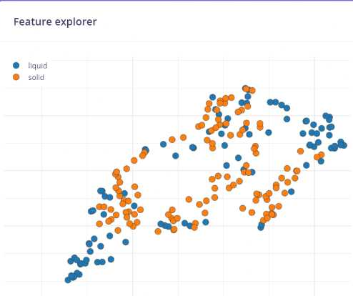
Feature map:

Slide 31
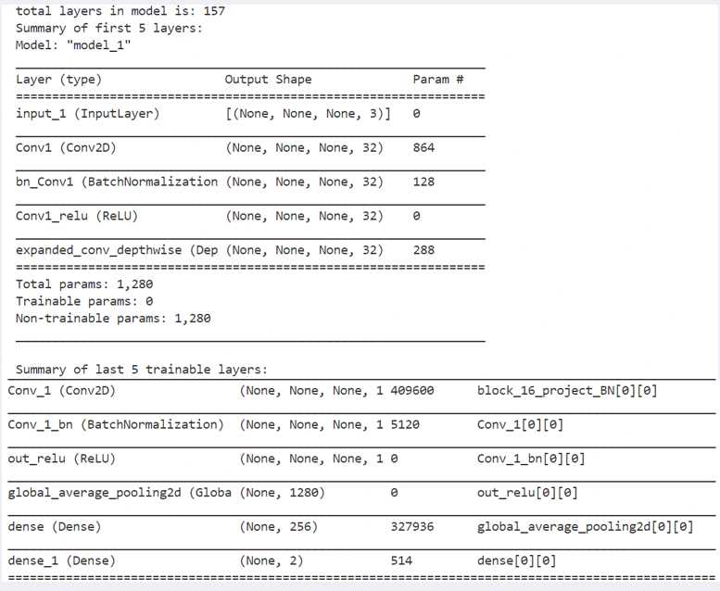
Model Layer outline:

Slide 32
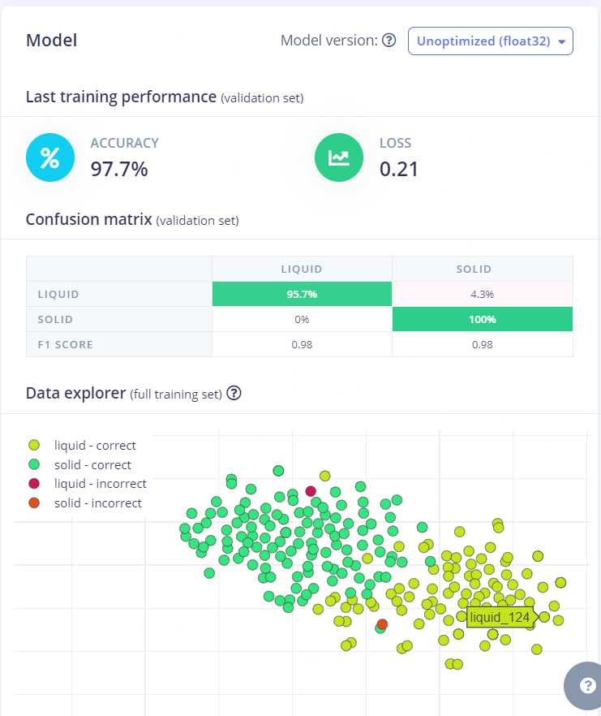
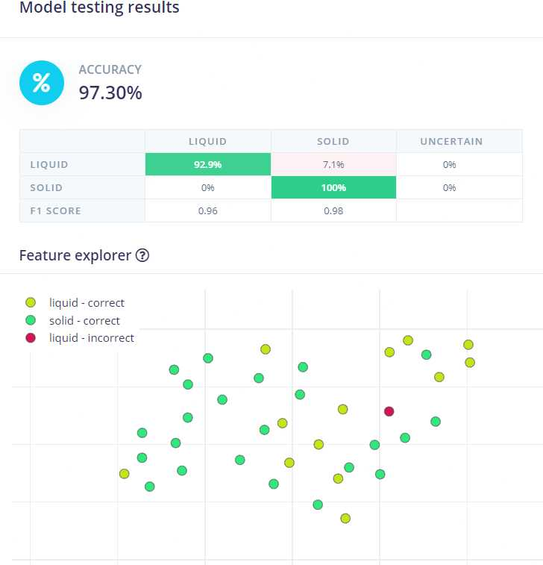

Slide 33
Data quantization:
We implemented a TensorFlow Model Optimization techniques to reduce the size of a pre-trained Keras model for deployment on resource-constrained devices. It applies pruning to remove unnecessary parameters, followed by quantization to convert model weights to lower precision formats. A representative dataset is used to calibrate the quantized model. The resulting TensorFlow Lite model is significantly smaller and faster, making it suitable for deployment on mobile and edge devices without compromising accuracy. This approach optimizes model storage and inference performance, facilitating efficient deployment in real-world applications.

Slide 34
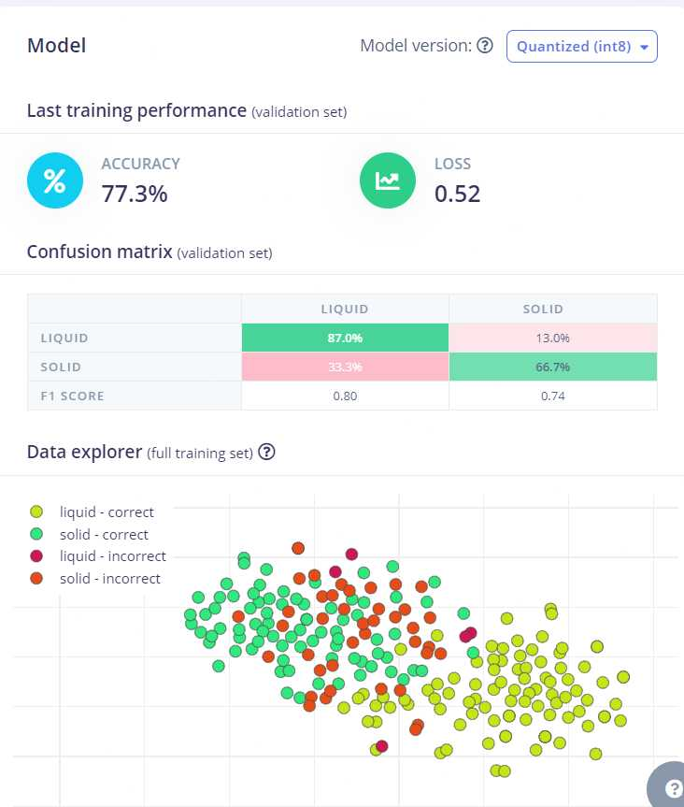

Slide 35
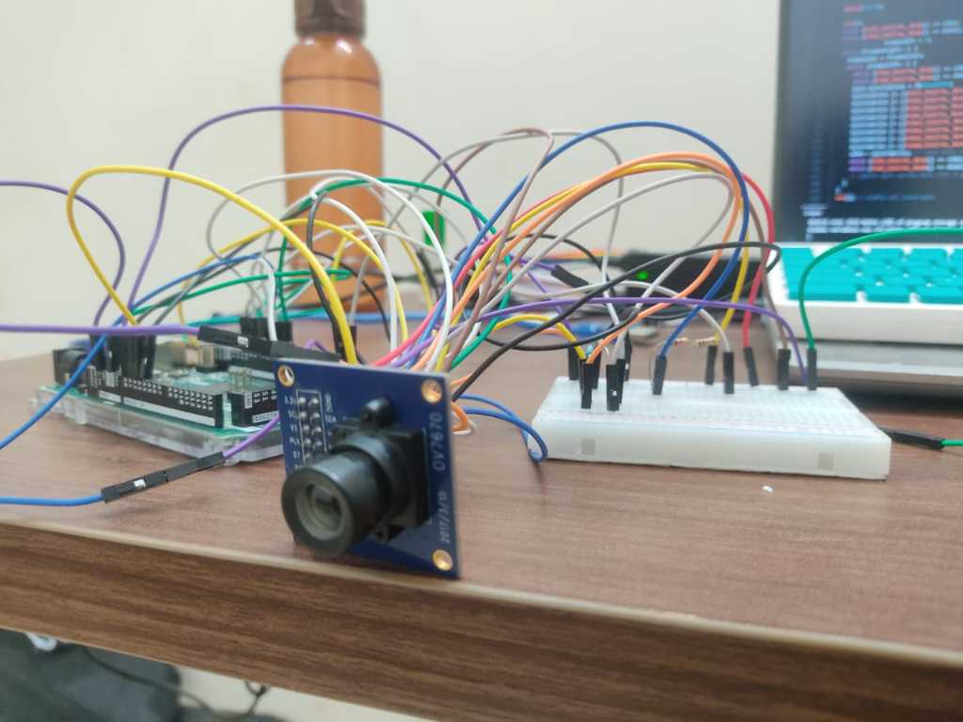
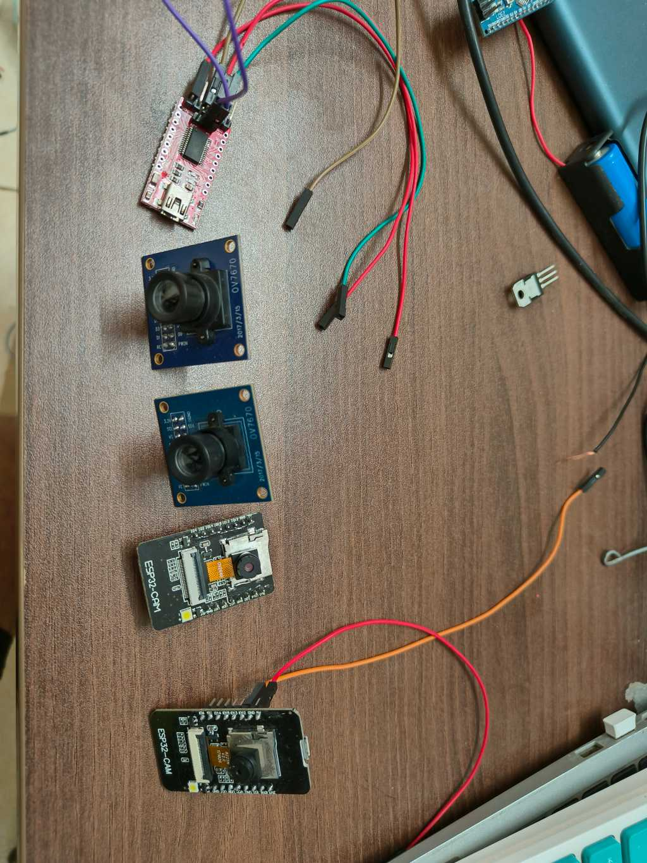
COMPLICATIONS & Troubleshooting:
Initial camera quality and Arduino library constraint
Fig 10 Different Camera Modules

Slide 36
EDGE IMPULSE AND LIBRARY IMPORT
Edge Impulse provides a streamlined solution for developing and deploying embedded machine learning models. Its library installation feature enables seamless integration of machine learning models into embedded applications by providing pre-built libraries compatible with popular development platforms. This simplifies the deployment process, allowing developers to efficiently incorporate machine learning capabilities into edge devices without the need for extensive manual configuration or optimization, accelerating time-to-market for AI-powered edge applications.

Slide 37
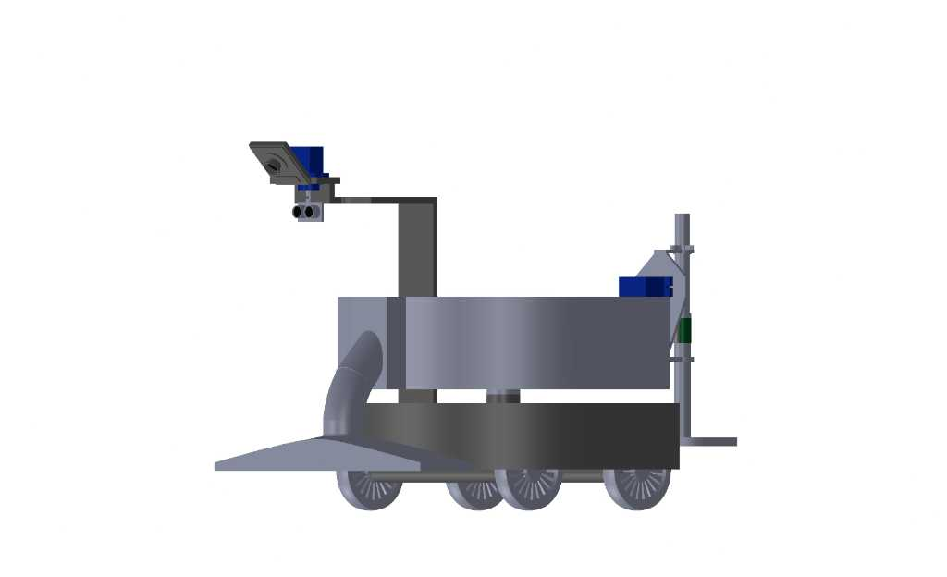
ROBOT LAYOUT DESIGN
Fig 11 Basic Layout of Robot

Slide 38
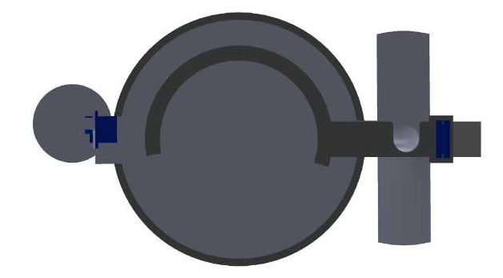
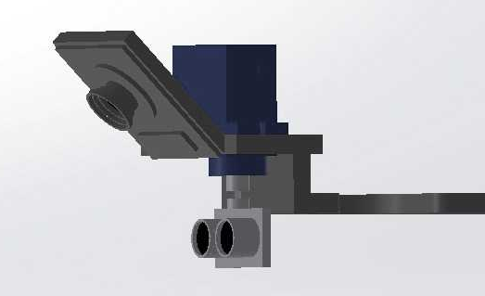
Fig 12 Camera and UV sensor placement
Fig 13 Top View of Robot

Slide 39
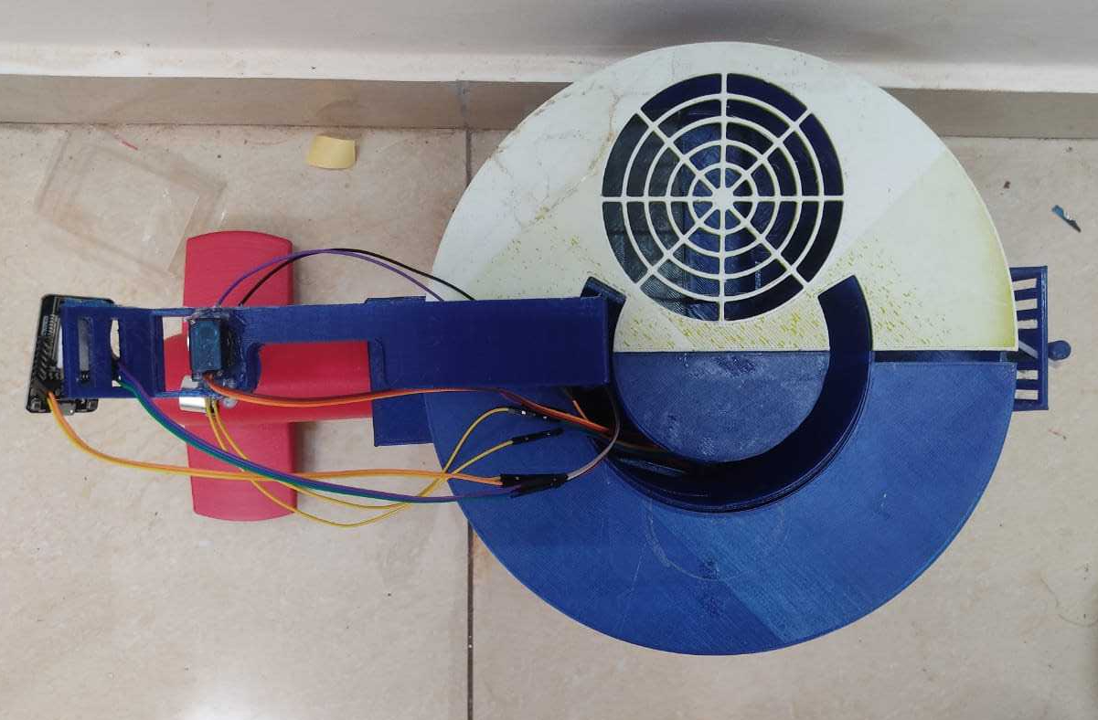
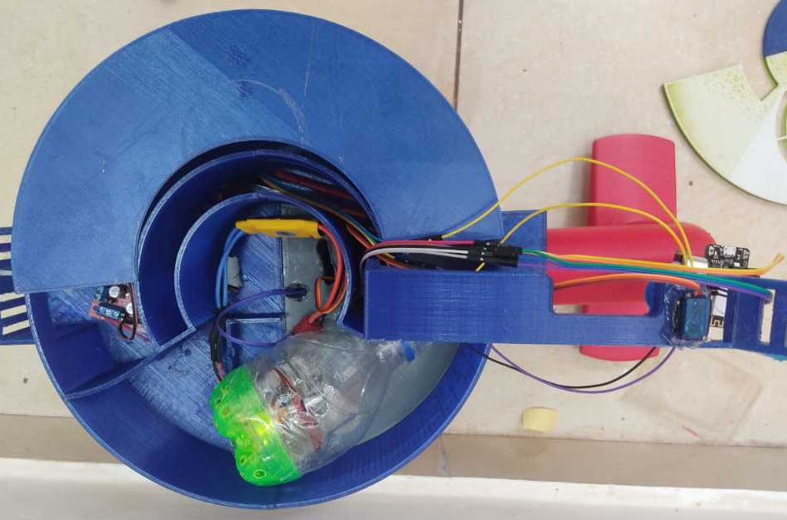
PROTOTYPE ASSEMBLY
Fig 14 Top view of Robot
Fig 15 BLDC motor with Suction

Slide 40
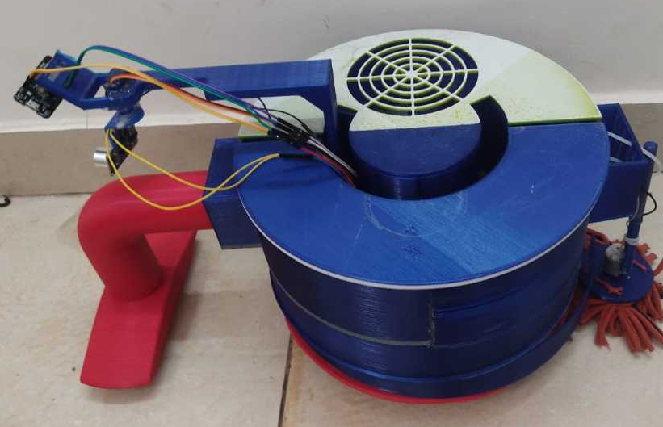
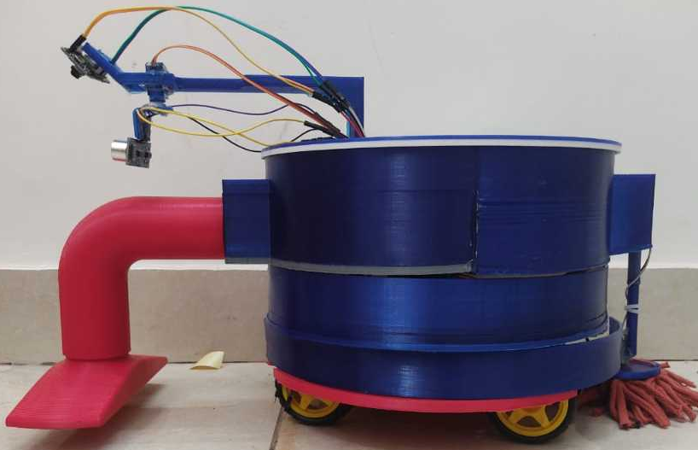
Fig 16 Left Top view of Robot
Fig 17 Side view of Robot

Slide 41
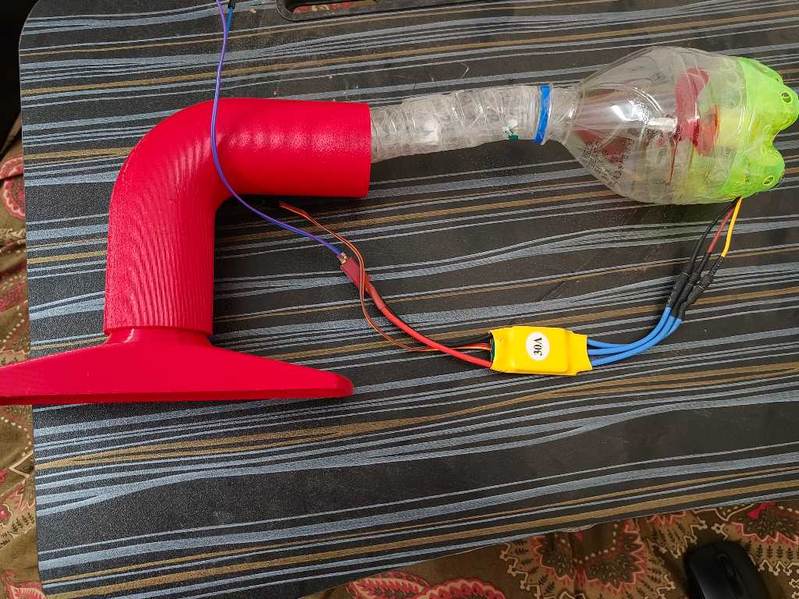
Fig 18 Suction part

Slide 42
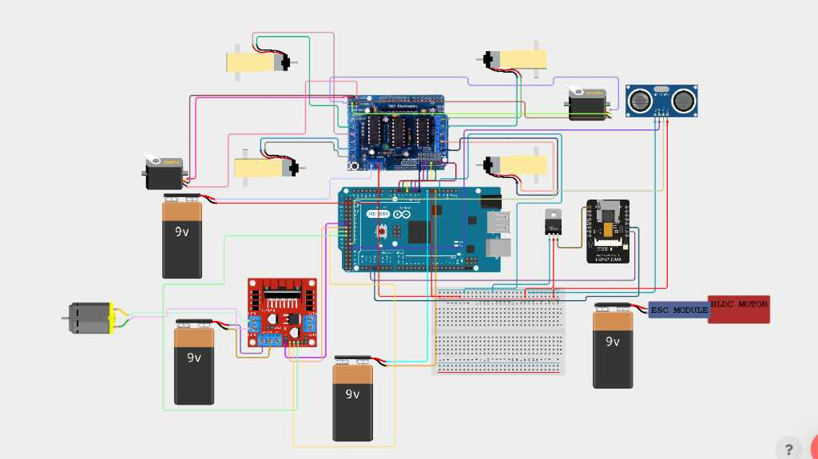
Arduino setup

Slide 43
Conclusion
Our journey began with meticulous collection and preparation of a diverse dataset, categorizing debris into "solid" and "liquid." Transfer learning with MobileNetV2 on ImageNet expedited model development, while quantization-aware training reduced model size for edge deployment. Integration with Edge Impulse enabled real-time inference on the ESP32 CAM, facilitating applications like environmental monitoring. Further enhancements could include refining the model architecture, exploring additional optimization techniques, and integrating real-time sensor data for advanced anomaly detection in disaster response scenarios.

Slide 44
References:
Ramalingam, B., Lakshmanan, A. K., Ilyas, M., Le, A. V., & Elara, M. R. (2018). Cascaded machine-learning technique for debris classification in floor-cleaning robot application. Applied Sciences, 8(12), 2649.
Yin, J., Apuroop, K. G. S., Tamilselvam, Y. K., Mohan, R. E., Ramalingam, B., & Le, A. V. (2020). Table cleaning task by human support robot using deep learning technique. Sensors, 20(6), 1698.
R. Gopalakrishnan, U. Ramani, K. U. Maheswari and M. Thilagaraj, "Design and Development of Controller Based Automatic Ground Cleaning Robot," 2022 6th International Conference on Computing Methodologies and Communication (ICCMC), Erode, India, 2022, pp. 491-494, doi:10.1109/ICCMC53470.2022.9753828.
Prassler, E., Ritter, A., Schaeffer, C. et al. A Short History of Cleaning Robots. Autonomous Robots 9, 211–226 (2000).
Mbunge, Elliot, et al. "Application of deep learning and machine learning models to detect COVID-19 face masks-A review." Sustainable Operations and Computers 2 (2021): 235-245.
Zhao, Zhong-Qiu, et al. "Object detection with deep learning: A review." IEEE transactions on neural networks and learning systems 30.11 (2019): 3212-3232.

Slide 45
Ferentinos, Konstantinos P. "Deep learning models for plant disease detection and diagnosis." Computers and electronics in agriculture 145 (2018): 311-318.
Zech, John R., et al. "Variable generalization performance of a deep learning model to detect pneumonia in chest radiographs: a cross-sectional study." PLoS medicine 15.11 (2018): e1002683.
Sankar, M.; Mudgal, D.; Jalinder, M.M.; et al: Green leaf disease detection using raspberry pi. In: 2019 1st International Conference on Innovations in Information and Communication Technology (ICIICT), pp. 1–6. IEEE (2019)
Venu, D. N. "IOT Surveillance Robot Using ESP-32 Wi-Fi CAM & Arduino." IJFANS International Journal of Food and Nutritional Sciences 11.5 (2022): 198-205.
Sanchez-Iborra, Ramon, and Antonio F. Skarmeta. "Tinyml-enabled frugal smart objects: Challenges and opportunities." IEEE Circuits and Systems Magazine 20.3 (2020): 4-18.
Rakib, Abdul Fattah, et al. "A lightweight quantized cnn model for plant disease recognition." Arabian Journal for Science and Engineering 49.3 (2024): 4097-4108.
A. Paul, N. Rakhaine, N. J. Ohee and A. Ahammad, "A Comprehensive Android App Based Solution for Automated Attendance and Management in Institutions Using IoT and TinyML," 2023 International Conference on Information and Communication Technology for Sustainable Development (ICICT4SD), Dhaka, Bangladesh, 2023, pp. 382-387, doi: 10.1109/ICICT4SD59951.2023.10303506

Slide 46
K. Dong, C. Zhou, Y. Ruan and Y. Li, "MobileNetV2 Model for Image Classification," 2020 2nd International Conference on Information Technology and Computer Application (ITCA), Guangzhou, China, 2020, pp. 476-480, doi: 10.1109/ITCA52113.2020.00106.
Gulzar, Yonis. "Fruit image classification model based on MobileNetV2 with deep transfer learning technique." Sustainability 15.3 (2023): 1906.
Indraswari, Rarasmaya, Rika Rokhana, and Wiwiet Herulambang. "Melanoma image classification based on MobileNetV2 network." Procedia computer science 197 (2022): 198-207
Warden, Pete, and Daniel Situnayake. Tinyml: Machine learning with tensorflow lite on arduino and ultra-low-power microcontrollers. O'Reilly Media, 2019.
Zim, Md Ziaul Haque. "TinyML: analysis of Xtensa LX6 microprocessor for neural network applications by ESP32 SoC." arXiv preprint arXiv:2106.10652 (2021).
Mach, Václav, et al. "Brushless DC motor control on arduino platform." Przeglad elektrotechniczny (2018).
Sudharsan, Bharath, Simone Salerno, and Rajiv Ranjan. "TinyML-CAM: 80 FPS image recognition in 1 kB RAM." Proceedings of the 28th Annual International Conference on Mobile Computing And Networking. 2022.

Slide 47
Thank you…

